Slide 1

RaceDay System Planning and Database Design
Title: RaceDay System Planning & Database Design
Subtitle: Part 1 - System Planning, ERD, API Endpoints, and SQL Schema
Presenter: Boikanyo Maleka
Student Number: ST10472664
Date: 04 September 2026

Slide 2


System Overview
Purpose: A comprehensive platform to manage running events, marathons, and charity races.
Key Roles:
Admin: System oversight.
Organiser: Creates events, manages categories, and records results.
Participant: Browses events, enrols in races, and views results.
Core Features: User authentication, event management, category-based enrolment, and race result tracking.

Slide 3
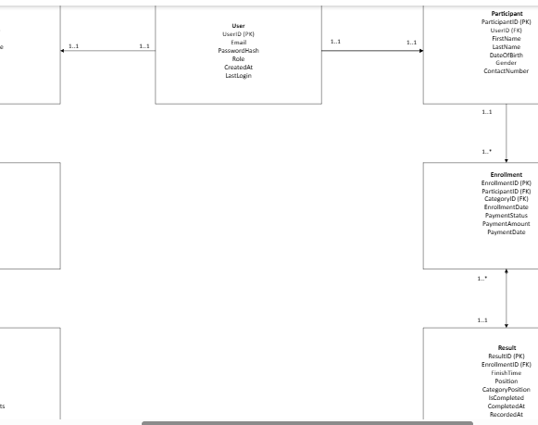

Section A: ERD
Total Entities: 7 (Exceeds the minimum requirement of 6)
Design Tool: Microsoft Visio
Notation: UML Notation

Slide 4

Entities and Attributes
User: Central authentication (Email, PasswordHash, Role).
Organiser & Participant: Profile details linked 1:1 to the User table.
Event: Core race details (Date, Location, MaxParticipants, Status).
Category: Race divisions (e.g., 5K, 10K, Half Marathon) with age/gender rules and entry fees.
Enrolment: The link between a Participant and a Category (includes PaymentStatus and BibNumber).
Result: Race outcomes (FinishTime, Position) linked to the Enrollment.

Slide 5

Relationships and Cardinalities
1:1 (One-to-One):
User ↔ Organiser
User ↔ Participant
Enrollment ↔ Result
1:M (One-to-Many):
Organiser → Event (One organiser hosts many events)
Event → Category (One event has many categories)
Participant → Enrolment (One participant has many enrollments)
Category → Enrolment (One category has many enrollments)

Slide 6

Section B: RESTful API Endpoint Plan
Total Endpoints Planned: 25+
Structure: RESTful architecture using standard HTTP methods (GET, POST, PUT, DELETE).
Security: Role-Based Access Control (RBAC) integrated into every endpoint.
Categories Covered:
Authentication & User Profiles
Organisers & Events
Categories & Enrollments
Results

Slide 7

Key API Endpoints
Auth: POST /api/auth/register, POST /api/auth/login
Events:
GET /api/events (Public)
POST /api/events (Organiser only)
Enrollments:
POST /api/events/{id}/categories/{id}/enroll (Participant)
Results:
POST /api/enrollments/{id}/result (Organiser)
GET /api/participants/results (Participant)

Slide 8
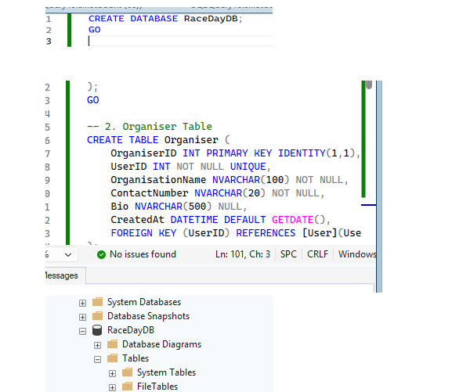

Section C: SQL Database Schema
Database Engine: SQL Server (SSMS)
Script Features:
Database creation (CREATE DATABASE RaceDayDB)
7 CREATE TABLE statements
Strict Constraints: PRIMARY KEY, FOREIGN KEY, NOT NULL, UNIQUE, CHECK
Data Seeding: INSERT statements with realistic sample data

Slide 9

Ensuring Data Integrity
Referential Integrity: Foreign Keys with ON DELETE CASCADE to prevent orphaned records.
Cascade Path Fix: Adjusted the Enrollment table to use NO ACTION on the Participant link to prevent SQL Server's "multiple cascade paths" error.
Business Rules via CHECK Constraints:
Role IN ('Admin', 'Organiser', 'Participant')
Gender IN ('Male', 'Female', 'Other')
PaymentStatus IN ('Pending', 'Paid', 'Refunded')

Slide 10

Sample Data
Users: 6 seeded users (2 Organisers, 4 Participants)
Events: 3 seeded events (Cape Town Marathon, Joburg 10K, Durban Charity Run)
Categories: 9 categories across the 3 events
Enrollments & Results: 9 sample enrollments with 8 recorded race results.
Purpose: Allows immediate testing of the API in Part 2 without manual data entry.

Slide 11

Conclusion and Next Steps
Planning Complete: The foundation for the RaceDay system is solid, scalable, and fully documented.
Documentation: All files (ERD.png, API_Plan.md, RaceDayDB_Script.sql) are committed to the /docs folder in the GitHub repository.
Next Steps (Part 2):
Implement the ASP.NET Core Web API.
Build the Controllers and Services based on the API plan.
Connect the API to the RaceDayDB SQL database.

